Slide 1
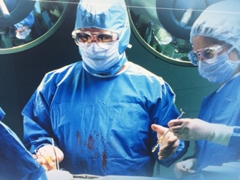
Infection Prevention and Control Working Group
Prof. Dr. Mohammad Murshed
HFRCMCH

Slide 2
We are trying to establish a
INFECTION PREVENTION AND CONTROL WORKING GROUP
IPCWG
Working group
Awareness program/Seminar
Training
Workshop
Hand hygiene
Sterilization
Isolation
Waste management

Slide 3
INFECTION PREVENTION AND CONTROL WORKING GROUP
IPCWG
We will create a working group with following mission and vision

Slide 4
Our Vision
INFECTION PREVENTION AND CONTROL WORKING GROUP
IPCWG
All health care providers will actively take part in ‘Standard Infection Control Practices’

Slide 5
Our Mission
INFECTION PREVENTION AND CONTROL WORKING GROUP
IPCWG
We will disseminate technological knowledge on infection control activities among the healthcare staff through
Seminar
hands on training
workshop

Slide 6
Our Objectives
INFECTION PREVENTION AND CONTROL WORKING GROUP
IPCWG
We will
Acquire expertise through sharing knowledge and observing standard practices

Slide 7
Our Objectives
INFECTION PREVENTION AND CONTROL WORKING GROUP
IPCWG
We will
Share our knowledge by establishing an academic center

Slide 8
Our Objectives
INFECTION PREVENTION AND CONTROL WORKING GROUP
IPCWG
We will
Educate the professionals involved in infection control

Slide 9
Our Objectives
INFECTION PREVENTION AND CONTROL WORKING GROUP
IPCWG
We will
Arrange National and International Seminars on Infection control

Slide 10
Our Objectives
INFECTION PREVENTION AND CONTROL WORKING GROUP
IPCWG
We will
Work with Government to ensure standard infection control practices in Bangladesh

Slide 11
INFECTION PREVENTION AND CONTROL WORKING GROUP
IPCWG
Infection Control and Prevention Program
in Bangladesh (ICPPB)
Venue
Lecture Gallery-1, Holy Family Red Crescent Medical College
Date: 9 January, 2008

Slide 13
Teaching on hand washing technique
Technical teaching

Slide 14
Posters at Hand washing places
INFECTION PREVENTION AND CONTROL WORKING GROUP
IPCWG

Slide 15
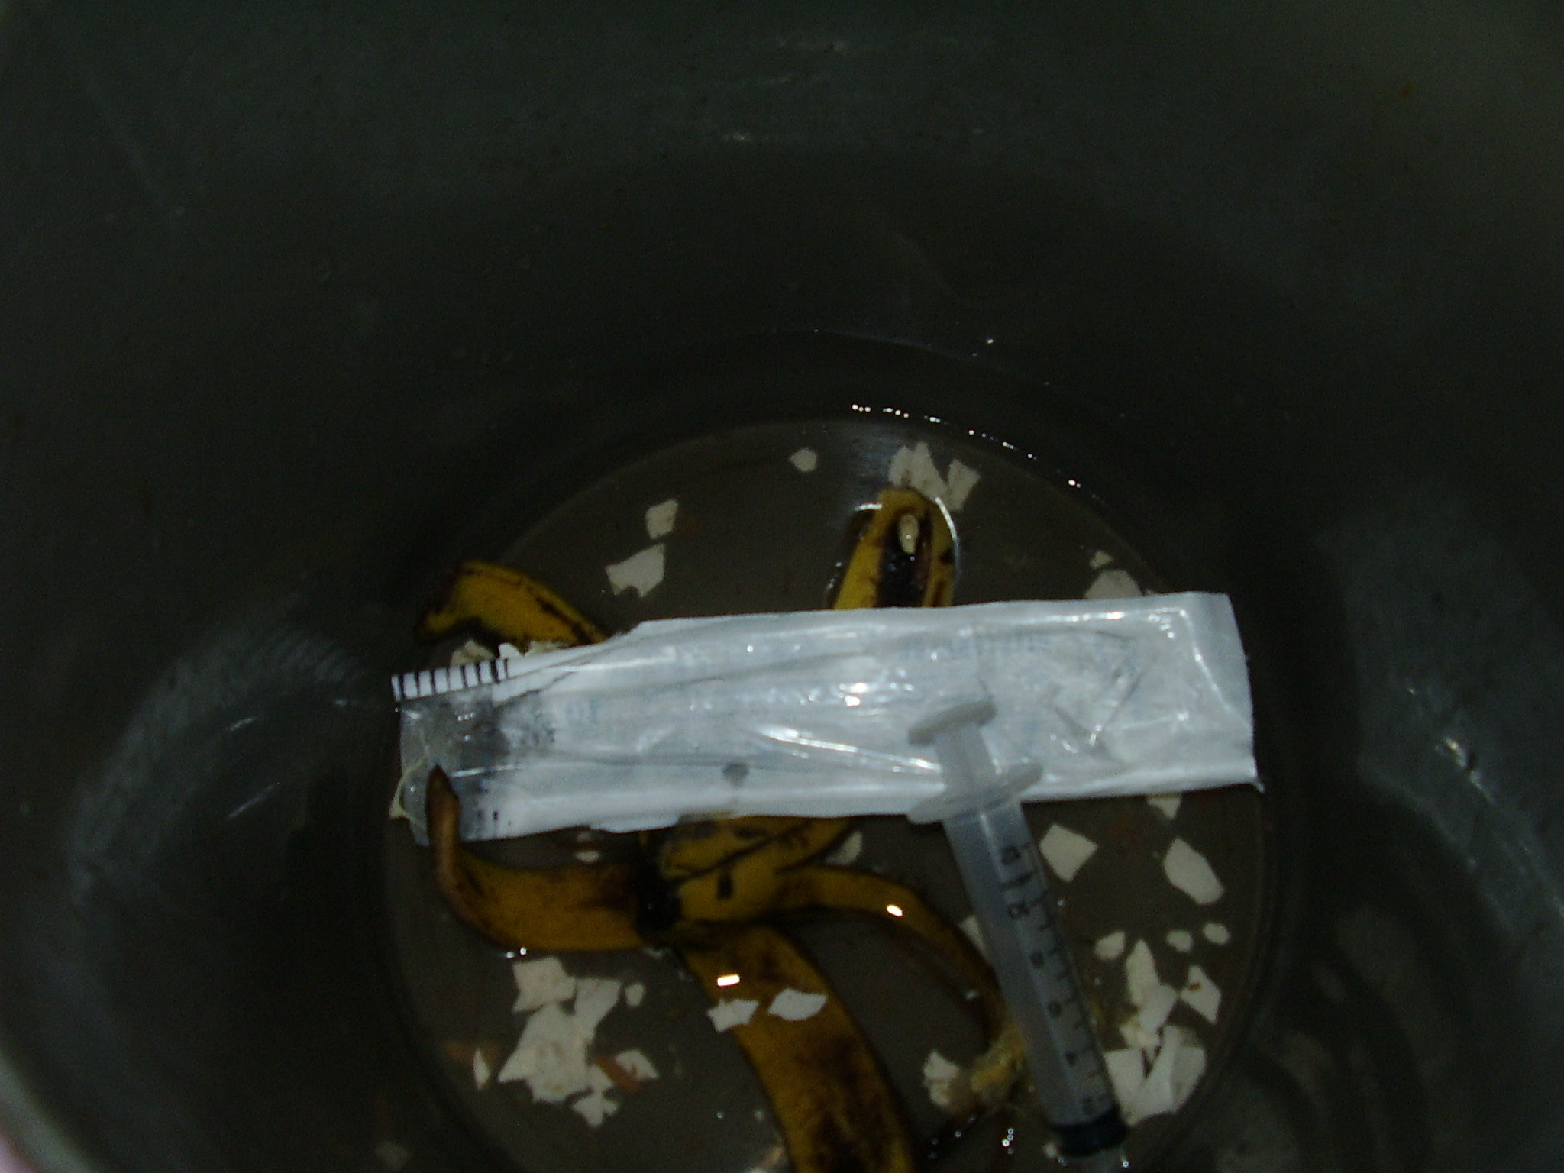
INFECTION PREVENTION AND CONTROL WORKING GROUP
IPCWG
This will directly go
to dust bean
A Tokai will pick this syringe

Slide 16
Please! Please! Please!
No!

Slide 17
INFECTION PREVENTION AND CONTROL WORKING GROUP
IPCWG
Safe disposal of Hospital wastes
Ordinary
Liquid
Infected
Sharps

Slide 18
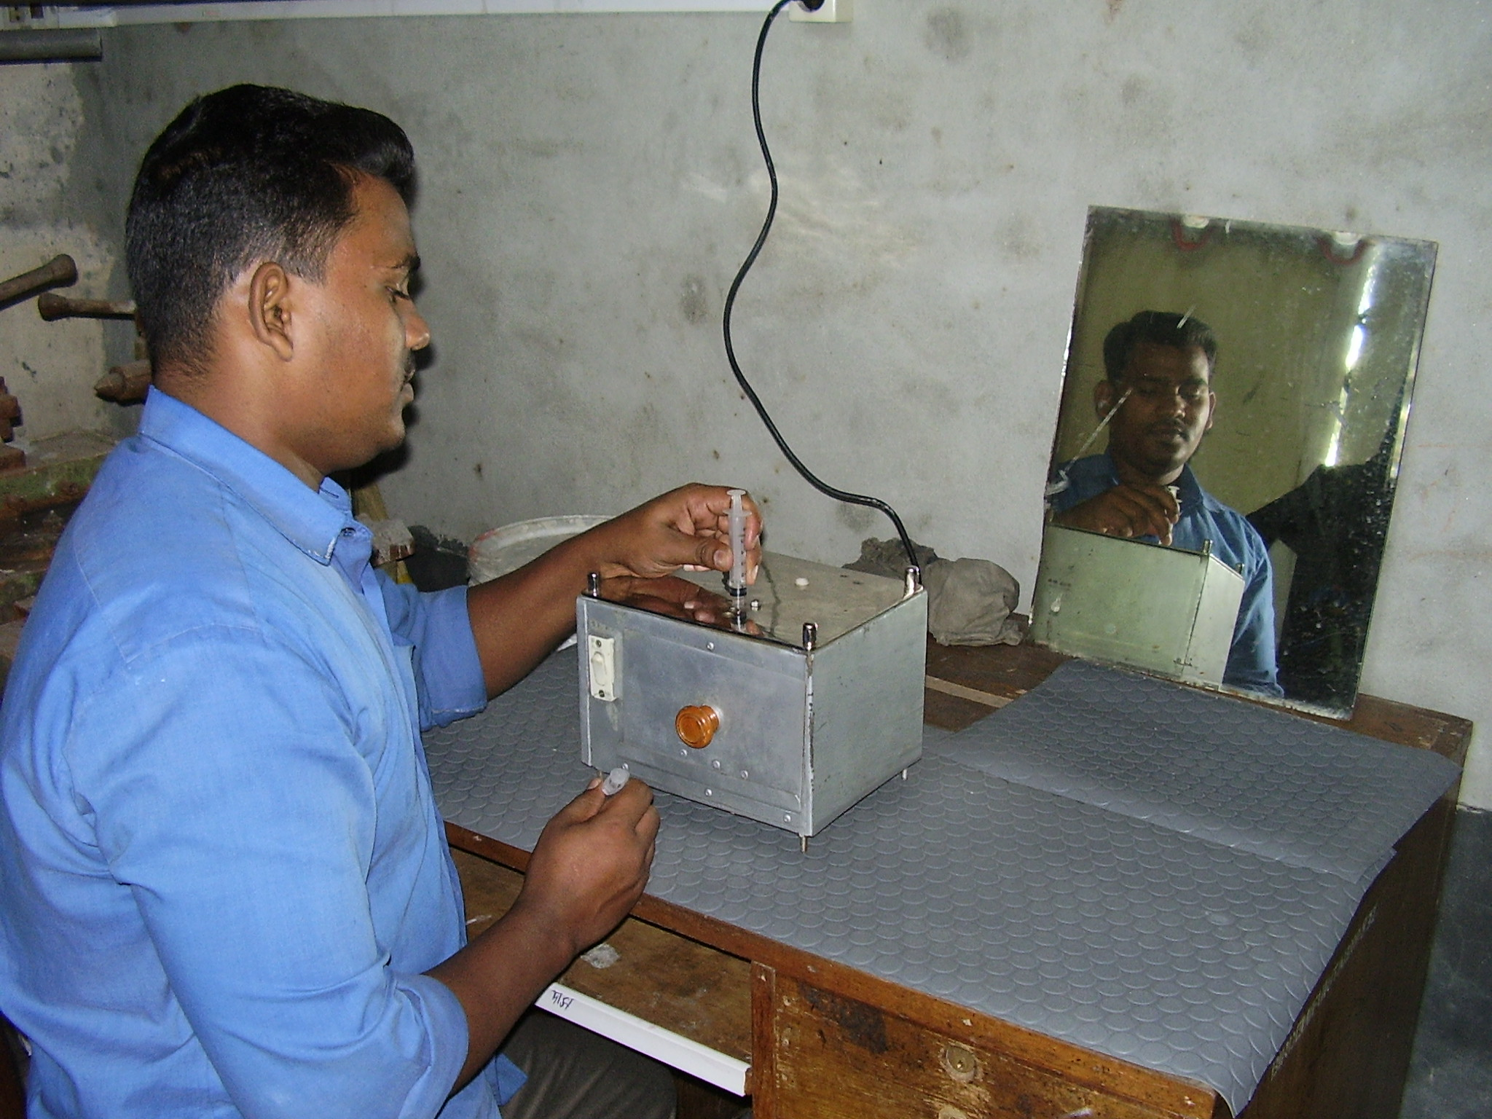
INFECTION PREVENTION AND CONTROL WORKING GROUP
IPCWG
Rajesh. He is cutting the mouth of the syringe

Slide 19
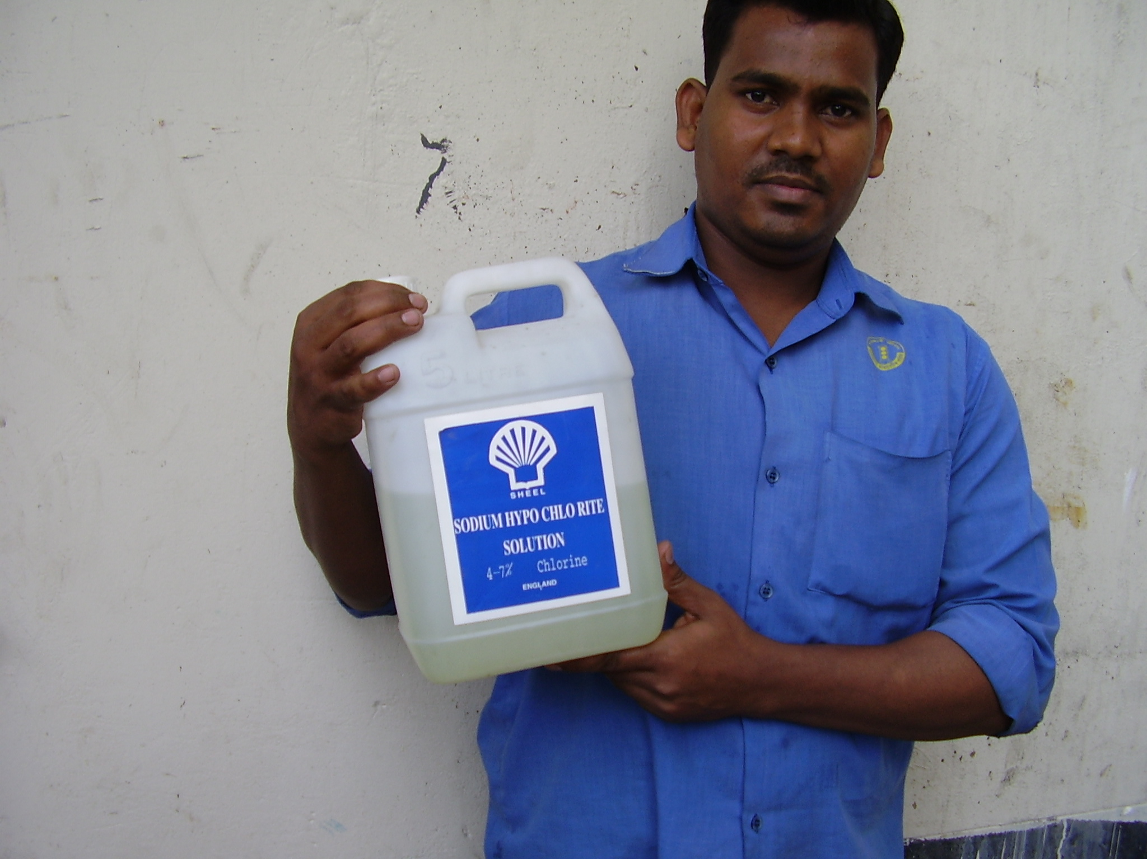
INFECTION PREVENTION AND CONTROL WORKING GROUP
IPCWG
Disinfect the Hospital environment

Slide 20
PPE includes
INFECTION PREVENTION AND CONTROL WORKING GROUP
IPCWG
gloves
gowns
shoe covers
head covers
mask
eye protection
face shield

Slide 21
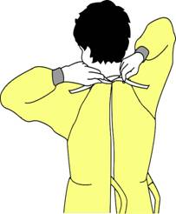
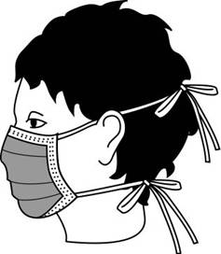
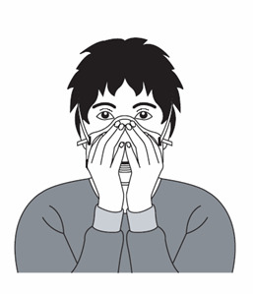
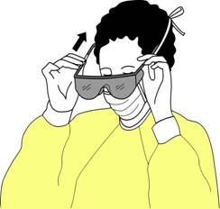
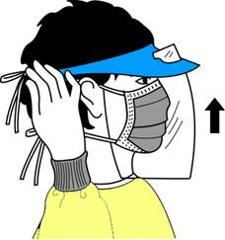
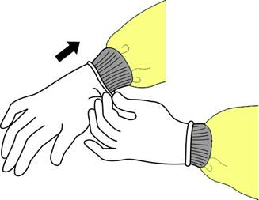
INFECTION PREVENTION AND CONTROL WORKING GROUP
IPCWG
Gown
Mask
Respirator
Goggles
Face shield
Gloves

Slide 22
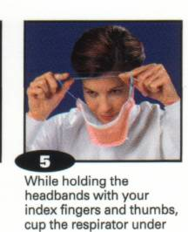
INFECTION PREVENTION AND CONTROL WORKING GROUP
IPCWG

Slide 23
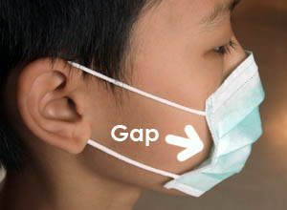
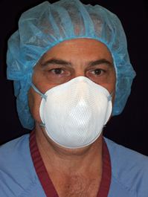
INFECTION PREVENTION AND CONTROL WORKING GROUP
IPCWG
Surgical mask
N 95 mask

Slide 24
INFECTION PREVENTION AND CONTROL WORKING GROUP
IPCWG
How to motivate
Health Care Workers and create awareness
?

Slide 25
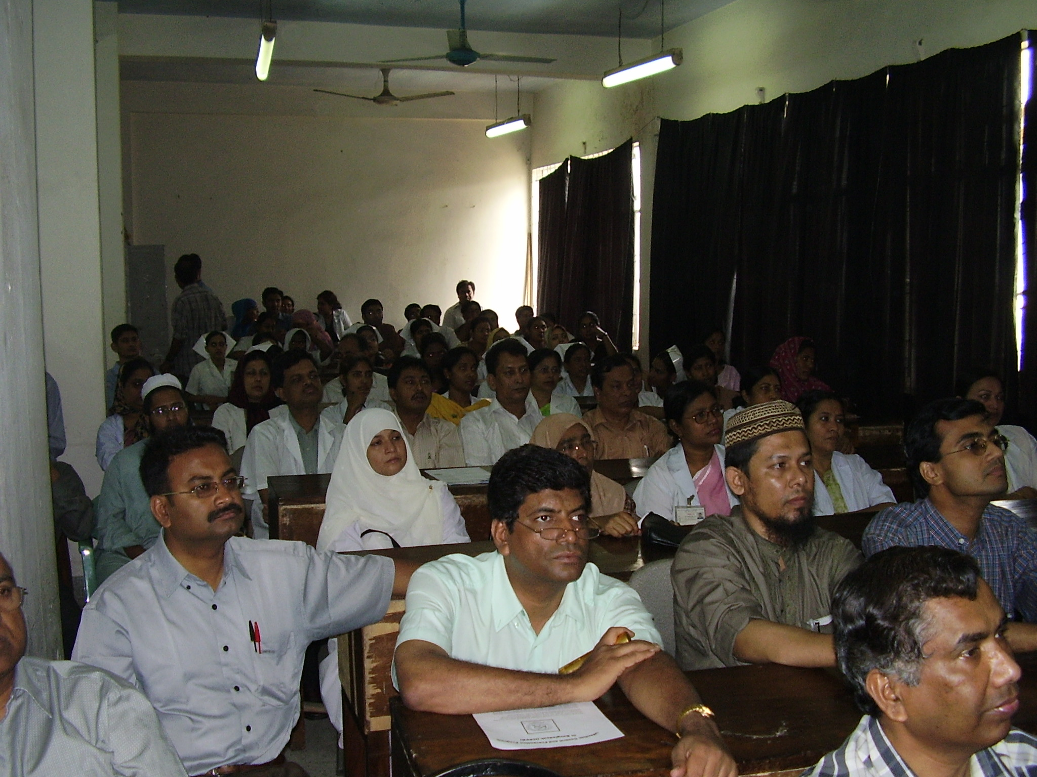
Dhaka National Medical College

Slide 26
INFECTION PREVENTION AND CONTROL WORKING GROUP
IPCWG

Slide 27
INFECTION PREVENTION AND CONTROL WORKING GROUP
IPCWG

Slide 28
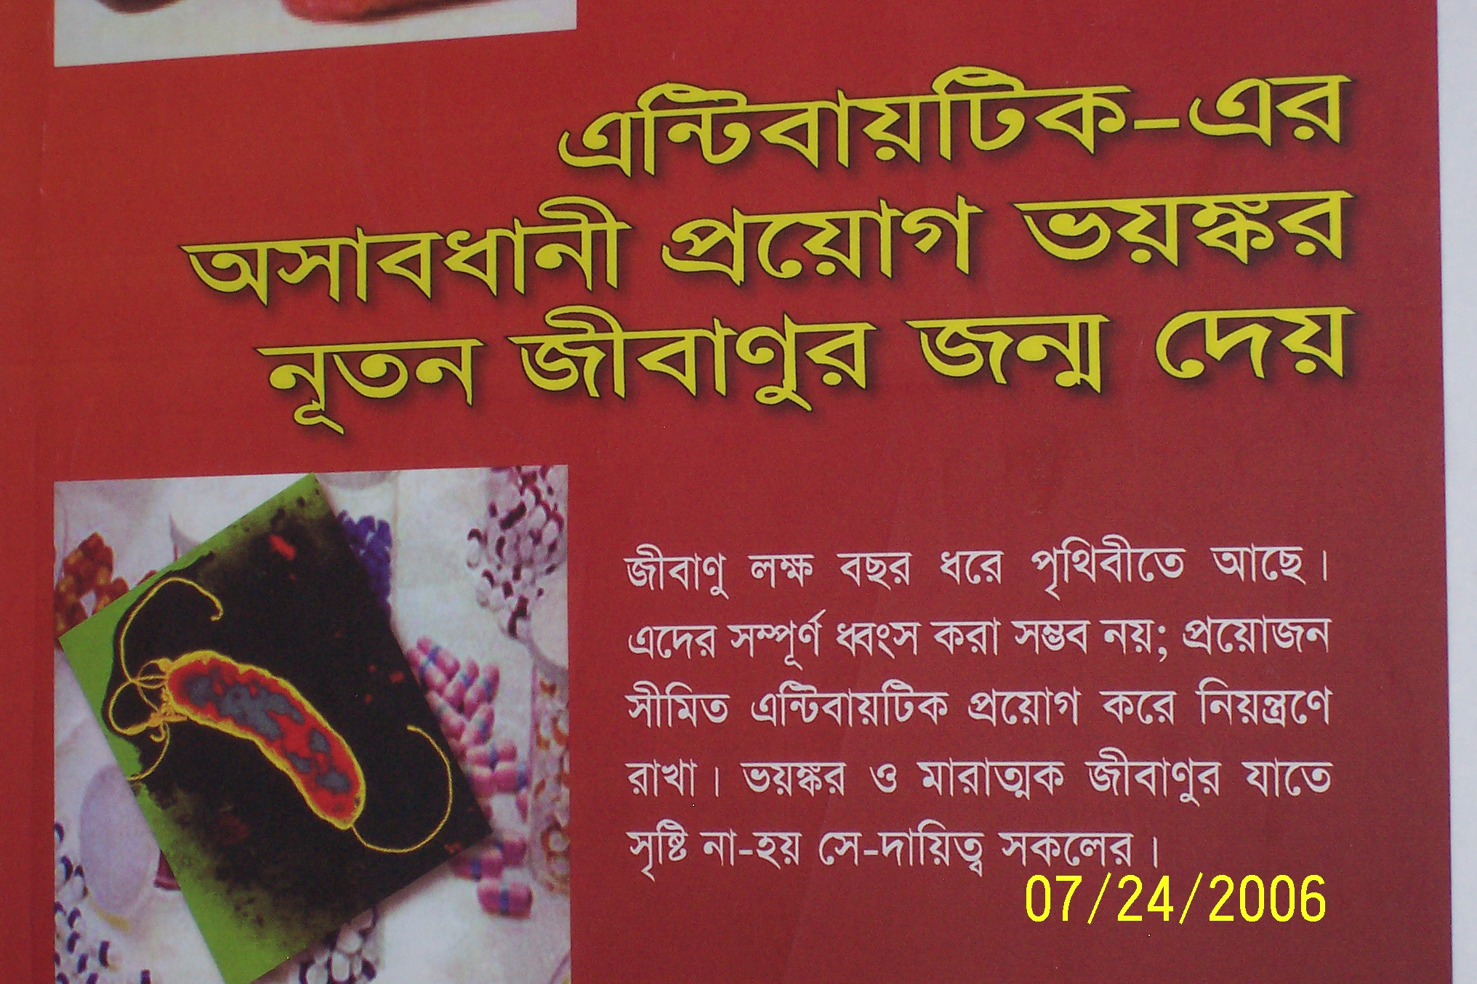
INFECTION PREVENTION AND CONTROL WORKING GROUP
IPCWG

Slide 29
INFECTION PREVENTION AND CONTROL WORKING GROUP
IPCWG

Slide 30
Video show on hand washing
INFECTION PREVENTION AND CONTROL WORKING GROUP
IPCWG
A Team Work
HFRCMCH

Slide 31
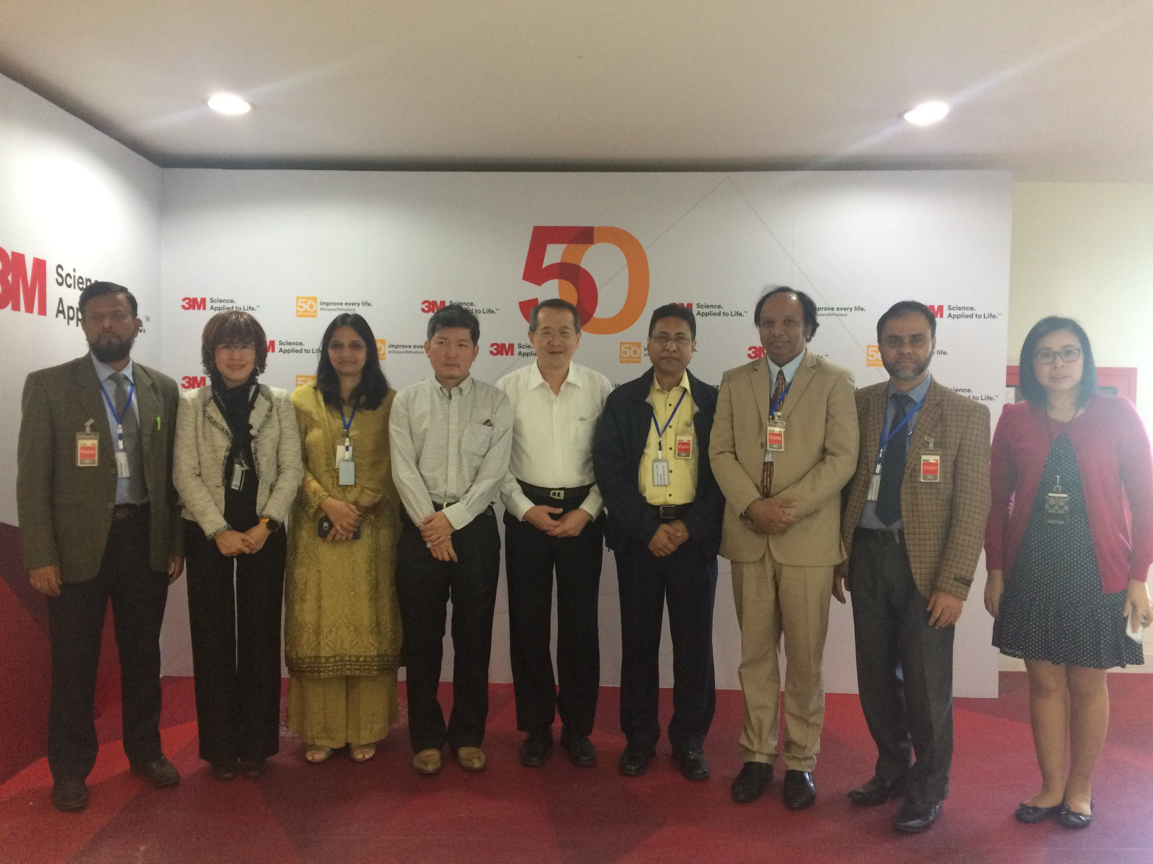
INFECTION PREVENTION AND CONTROL WORKING GROUP
IPCWG

Slide 32
INFECTION PREVENTION AND CONTROL WORKING GROUP
IPCWG

Slide 33
INFECTION PREVENTION AND CONTROL WORKING GROUP
IPCWG

